Slide 1
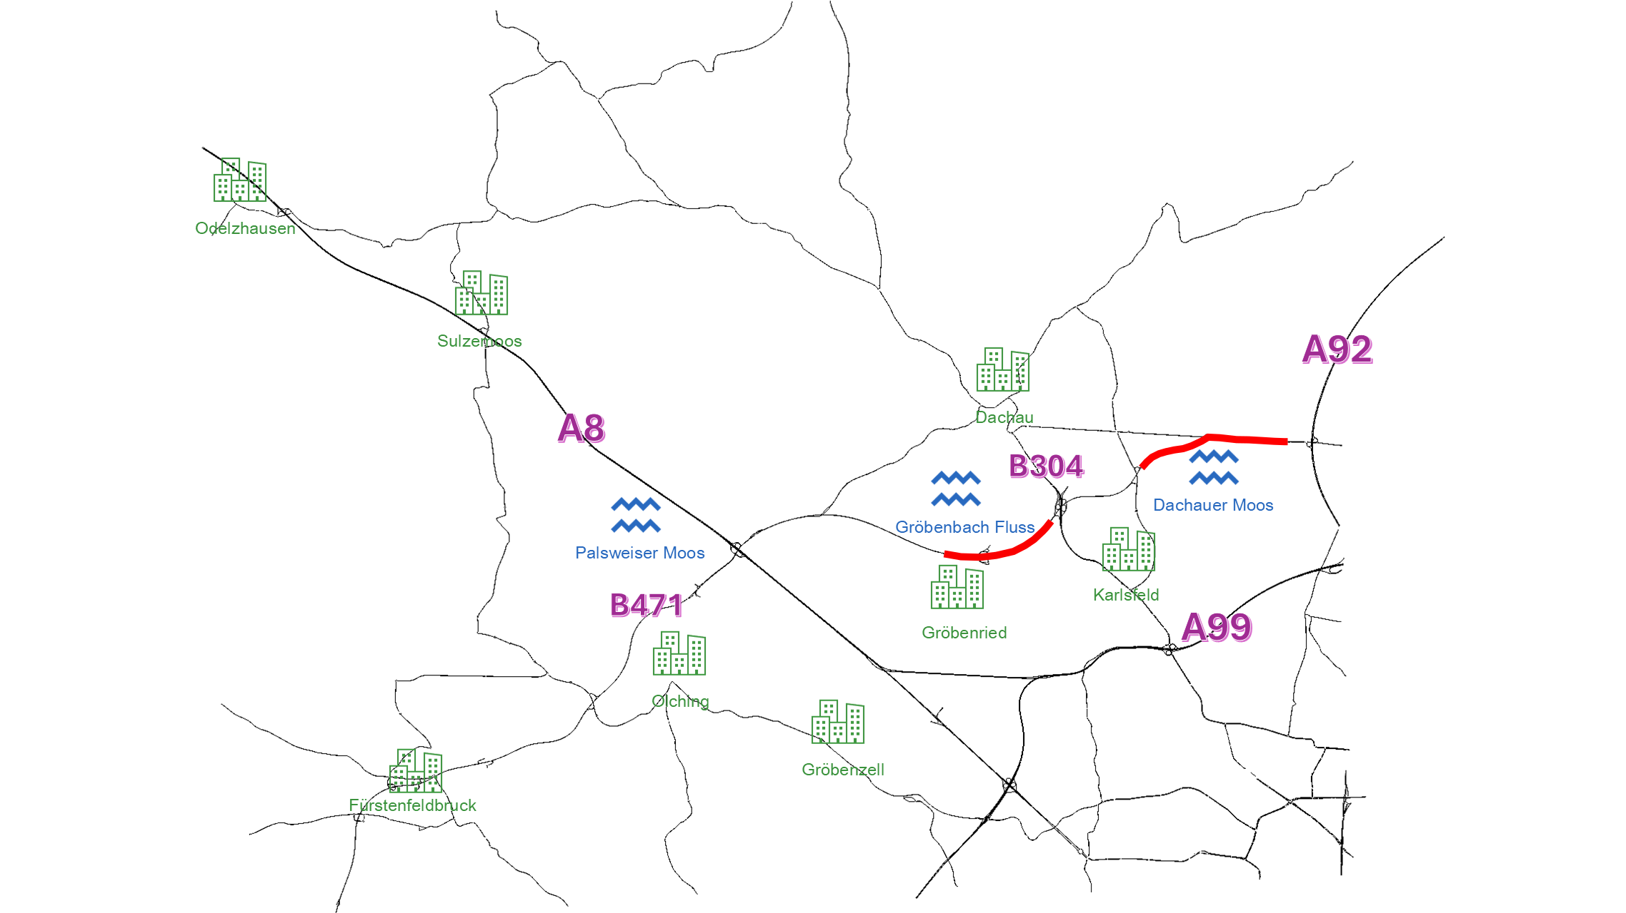
Town
Water
Motorway
Federal road
Lightly flooding segment

Slide 2
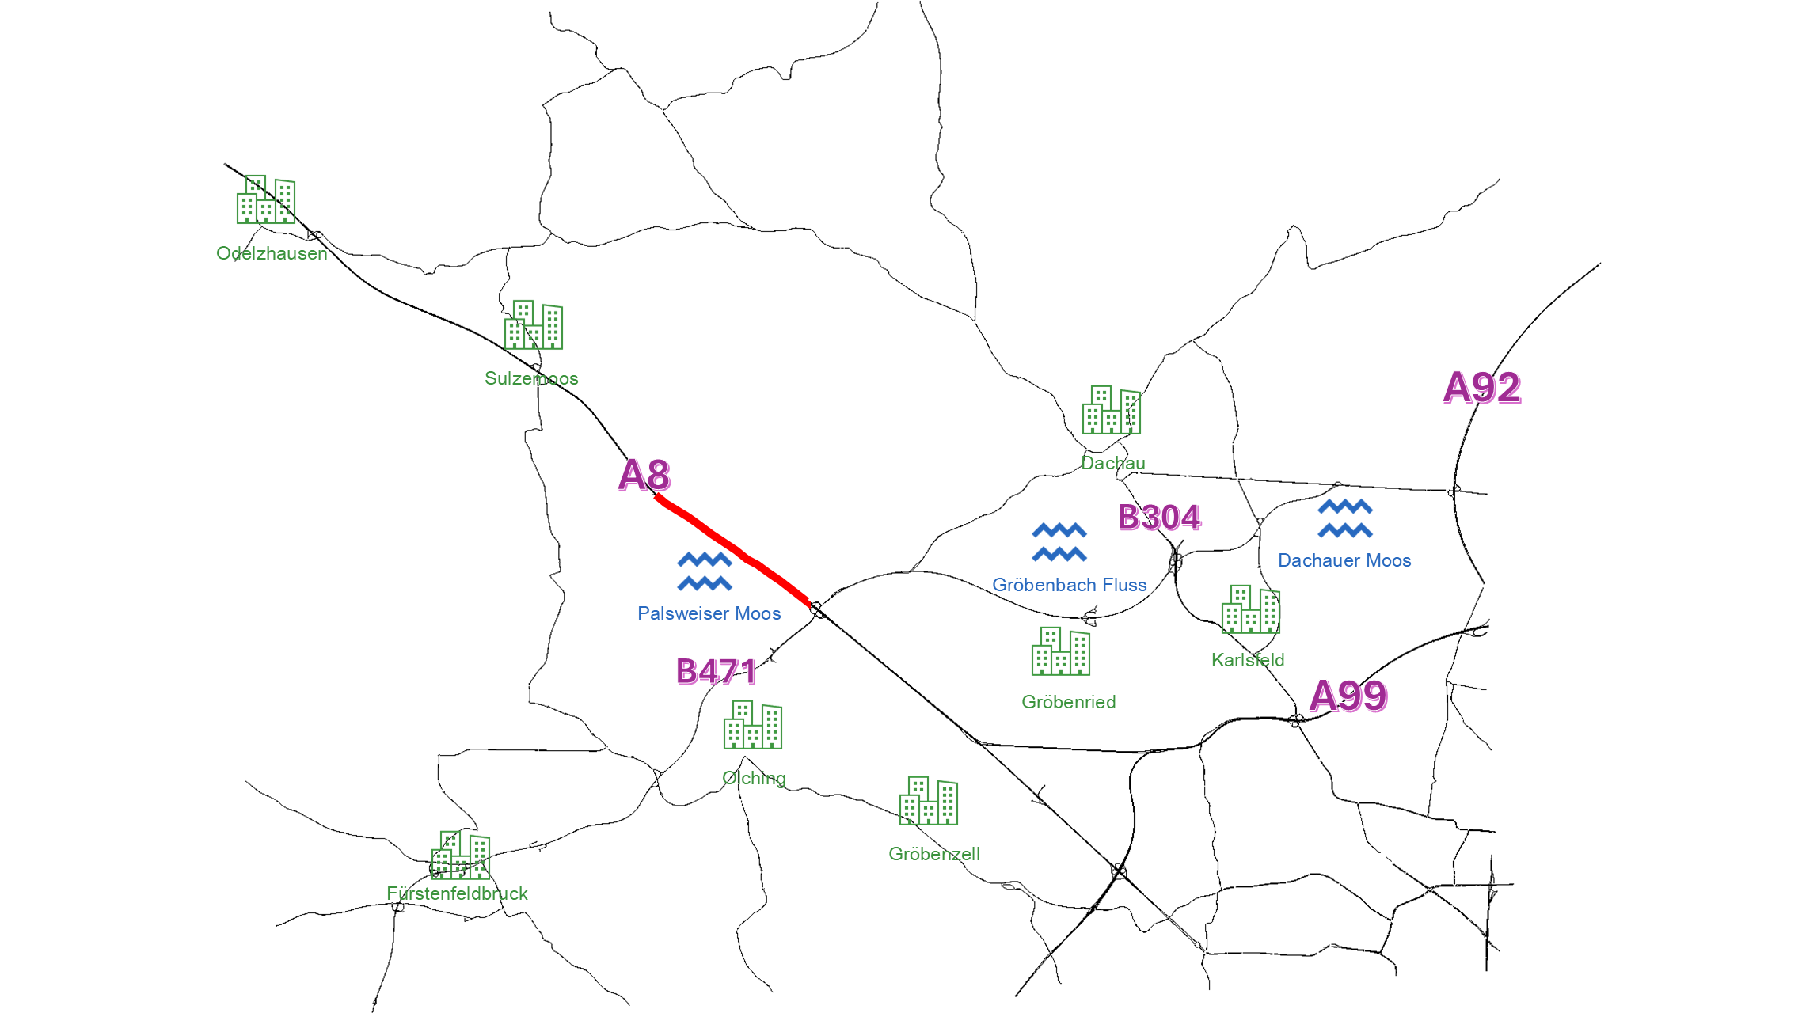
Town
Water
Motorway
Federal road
Moderate flooding segment

Slide 3
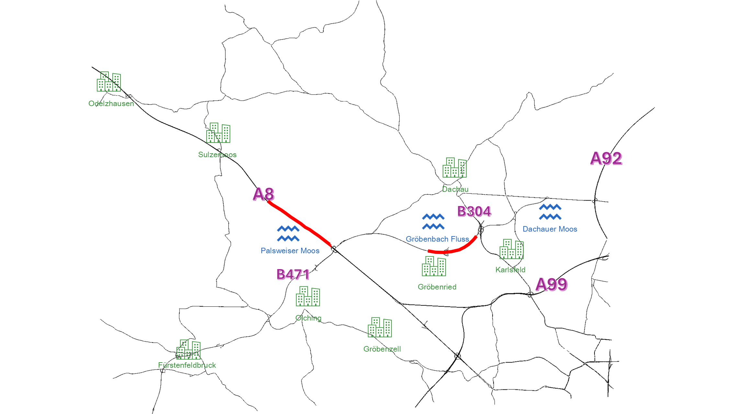
Town
Water
Motorway
Federal road
Severe flooding segment

Slide 4
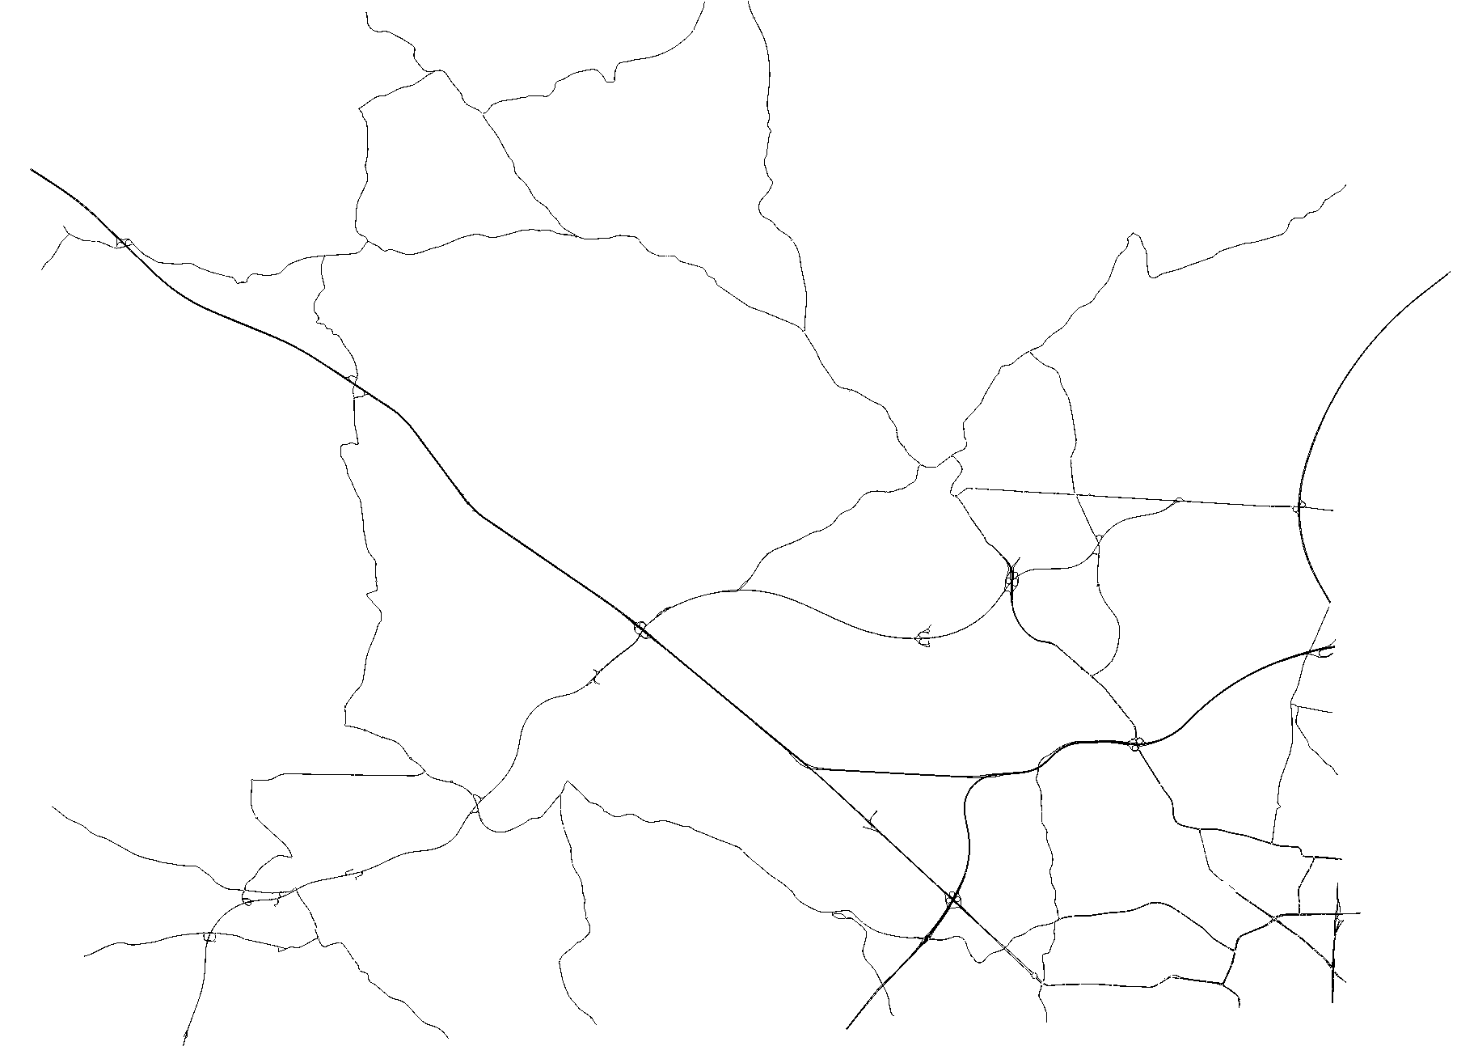
Odelzhausen
Sulzemoos
A92
A8
Dachau
B304
Dachauer Moos
Palsweiser Moos
Gröbenbach Fluss
B471
Karlsfeld
A99
Gröbenried
Olching
Gröbenzell
Fürstenfeldbruck

